Slide 1
Introduction to Java Web Application

Slide 2
Objectives
Introduction to java web application
+ The core and basic of Java web server technologies
+ Java web application technologies
Setup Environment :
JDK: 1.7 or higher
Servlet container: Tomcat 8, Glassfish 4.1, etc.
Intergrate Netbeans 8. with the web container.
File – Directory structure
Deployment Descriptor
Package web application
Deploy the web application
Creating/Building the first application
<number>/41

Slide 3
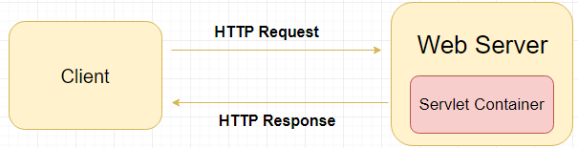
Java web application
Java web application provides dynamic web pages for communication between client & server
Java provides support for web application through Servlets and JSPs – core java web technology
Java web server: web container- servlet container- servlet engine
<number>/41

Slide 4
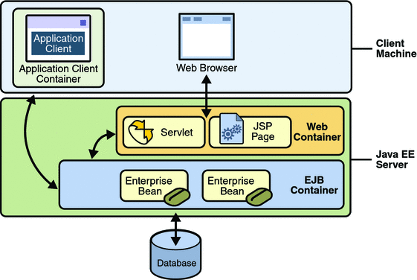
Java web application
Application server provide J2EE technology for java web application
<number>/41

Slide 5
File and Directory Structure
A Place for Everything and Everything in Its Place.
Construct the file and directory structure of a Web Application that may contain:
  static content,
  JSP pages,
  servlet classes,
  the deployment descriptor,
  tag libraries,
  JAR files and Java class files;
  and describe how to protect
  resource files from HTTP access.
<number>/41

Slide 6
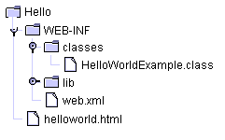
Special Directories Beneath the Context Root
/WEB-INF/classes—for classes that exist as separate Java classes (not packaged within JAR files).
/WEB-INF/ lib—for JAR files, supporting classes that connect to databases—whatever library.
web.xml, the deployment descriptor file.
<number>/41

Slide 7
Deployment Descriptor
Deployment descriptor describes the classes, resources and configuration of the application
When the web server receives a request for the application, it uses the deployment descriptor to map the URL of the request to the code that handle the request.
The deployment descriptor is a file named web.xml. It resides under the WEB-INF/ directory.
The file is an XML file whose root element is <web-app>
<number>/41

Slide 8
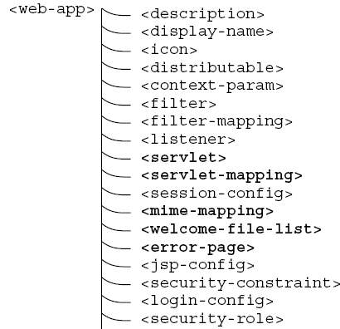
Structure of the Deployment Descriptor.
<number>/41
Notes:
MINE-Multi-purpose Internet Mail Extensions

Slide 9
Deployment Descriptor simple web.xml
<?xml version="1.0" encoding="ISO-8859-1"?>
<web-app xmlns="http://java.sun.com/xml/ns/j2ee"
xmlns:xsi="http://www.w3.org/2001/XMLSchema-instance"
xsi:schemaLocation=http://java.sun.com/xml/ns/j2ee http://java.sun.com/xml/ns/j2ee/web-app_2_4.xsd version="2.4">
<display-name>Servlet 2.4 Examples</display-name>
<description>
Servlet 2.4 Examples.
</description>
<!-- Define servlets that are included in the example application -->
<servlet>
<servlet-name>FirstServlet</servlet-name>
<servlet-class>FirstServlet</servlet-class>
</servlet>
<servlet-mapping>
<servlet-name>FirstServlet</servlet-name>
<url-pattern>/FirstServlet</url-pattern>
</servlet-mapping>
</web-app>
<number>/41

Slide 10
Welcome Files
<welcome-file-list>
  <welcome-file>index.html</welcome-file>
  <welcome-file>index.jsp</welcome-file>
  <welcome-file>mainlibrary/catalog.jsp</welcome-file>
</welcome-file-list>
<number>/41

Slide 11
Packaging Your Web Application
Web modules are packaged as JAR files with a .war (web archive) extension
WARs are packaged for a different purpose: to make it as easy as possible for a web container to deploy an application.
Web modules contain servlet class files, web files, supporting class files, image and HTML files, and web application deployment descriptor.
NetBean: Project name-> Build
<number>/41
Notes:
oject

Slide 12
Deploy web application
Several web containers have automatic deployment mechanisms.
The server recommended for this course—Tomcat 7.x or Glassfish 4.x—has a “webapps” directory.
  Place a WAR file in this directory, and Tomcat (by default) will un-jar the contents into the file system under the webapps directory.
  a context root directory is the same name as the WAR file (but without the .war extension)— then makes the application available for use.
<number>/41

Slide 13
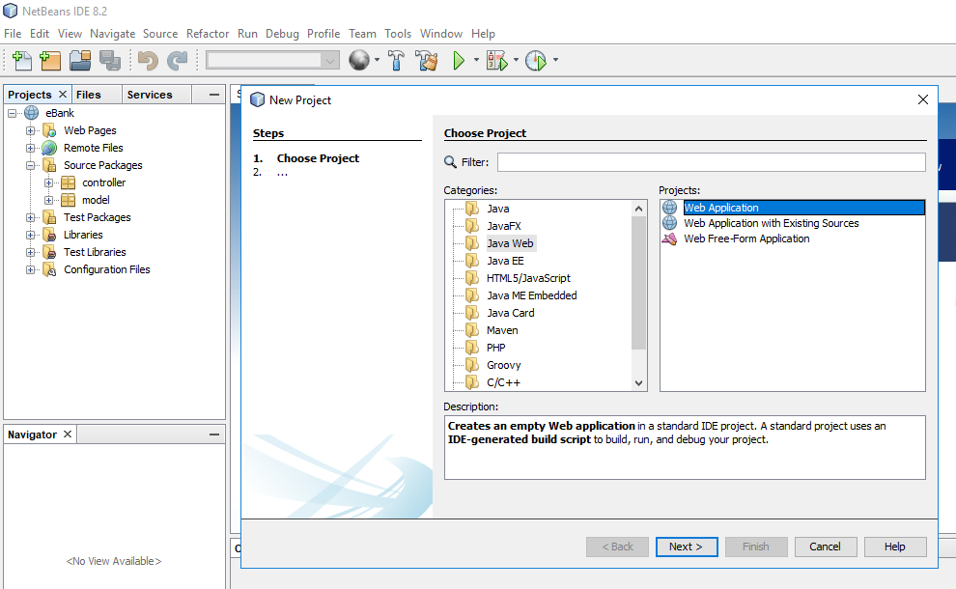
Create first web application
<number>/41

Slide 14
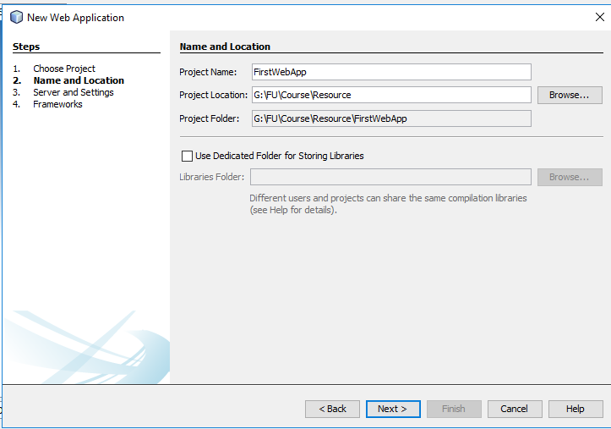
Create first web application
<number>/41

Slide 15
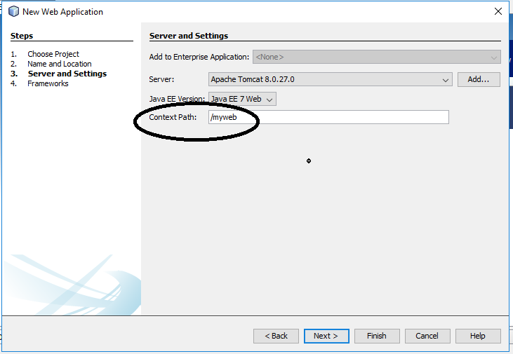
Create first web application
<number>/41

Slide 16
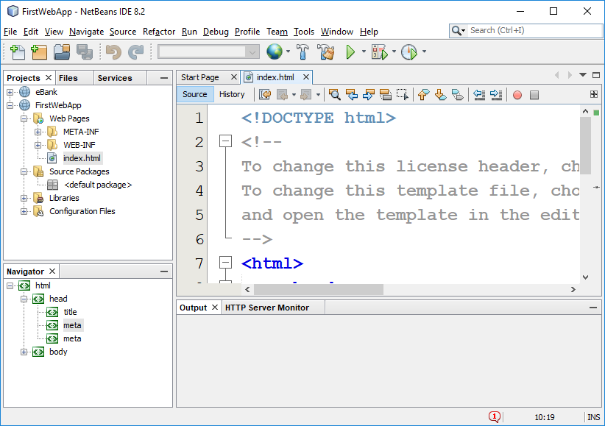
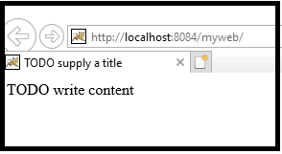
Create first web application
<number>/41

Slide 17
Summary
Java Web application
Core technology of Java web
Java web server – Application server
Web container – Servlet container
File and Directory Structure
Deployment Descriptor
Package WAR Files
Deploy web application
<number>/41

Slide 18
Constructive question
Compare general web server and Java web server
When a user enter username and password to login a java web application, what does the server do? List the tasks in order of execution.
When a user accesses a java web application from a browser, what does the web server do?
As a developer, how do you deploy web app?
<number>/41

